Slide 1
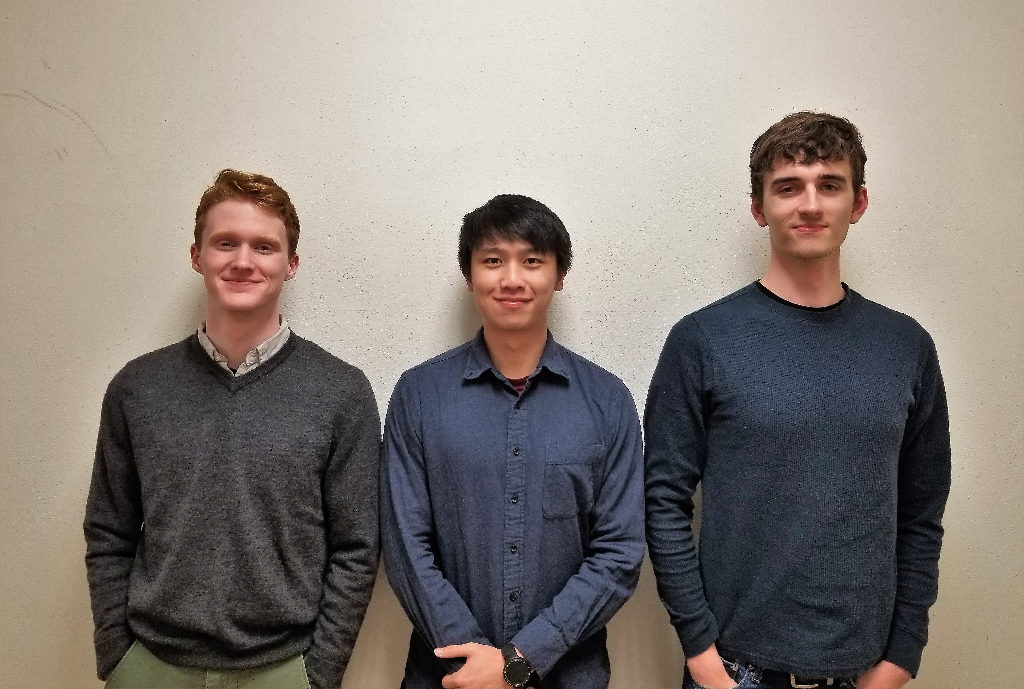

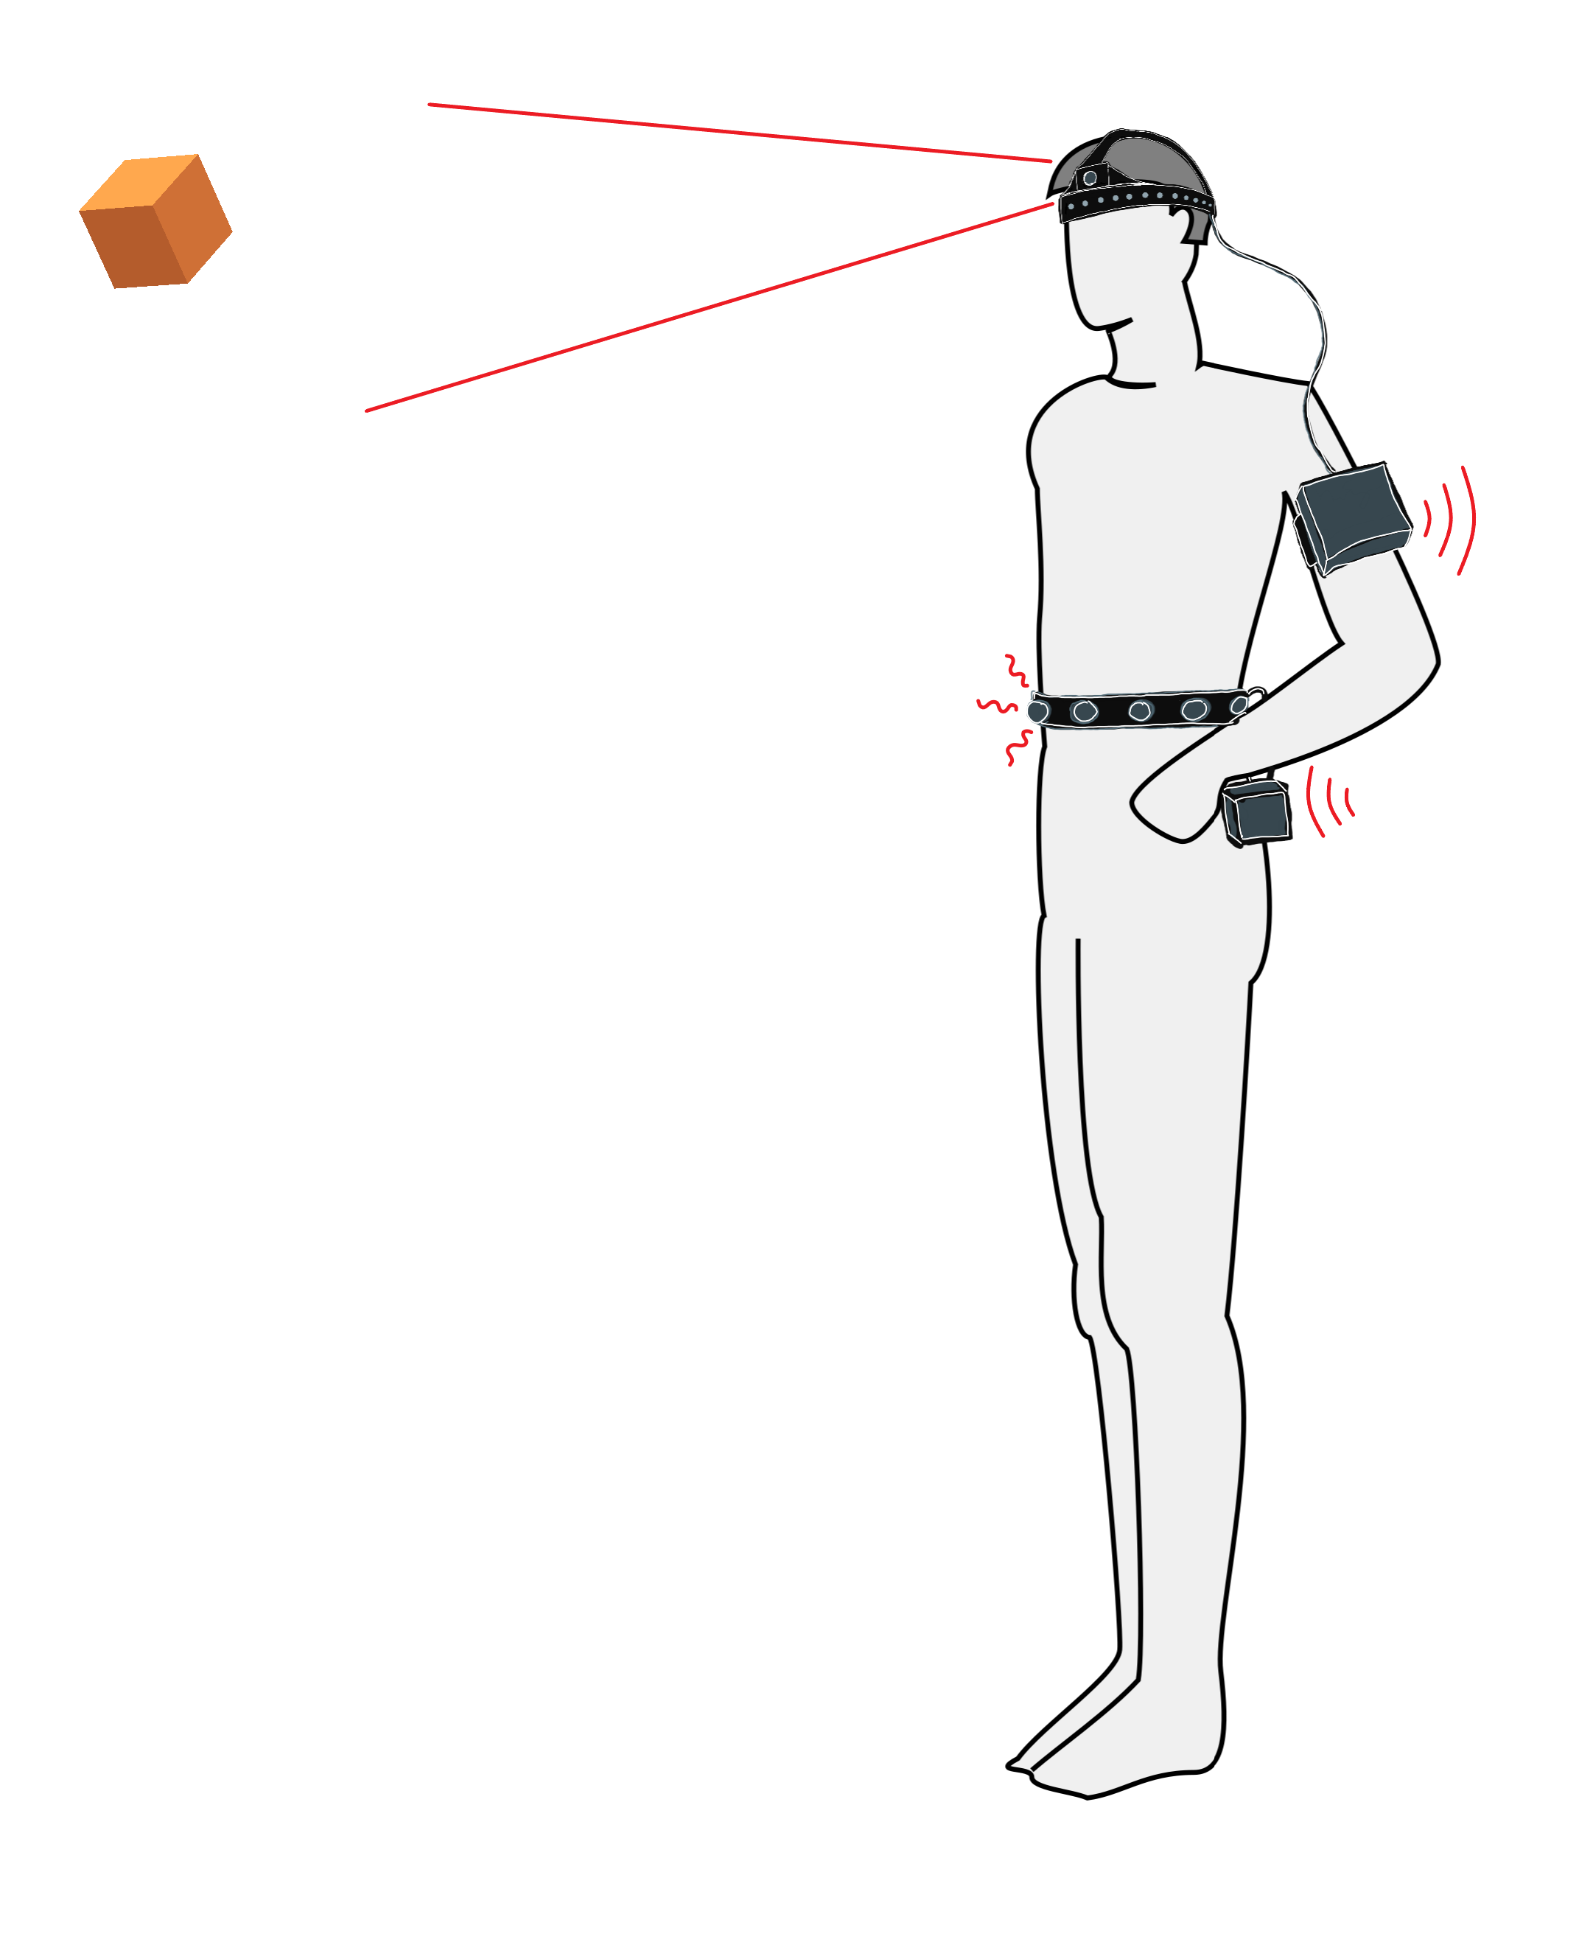
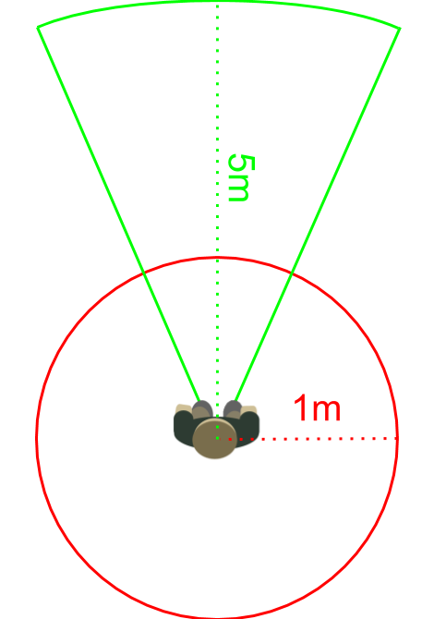
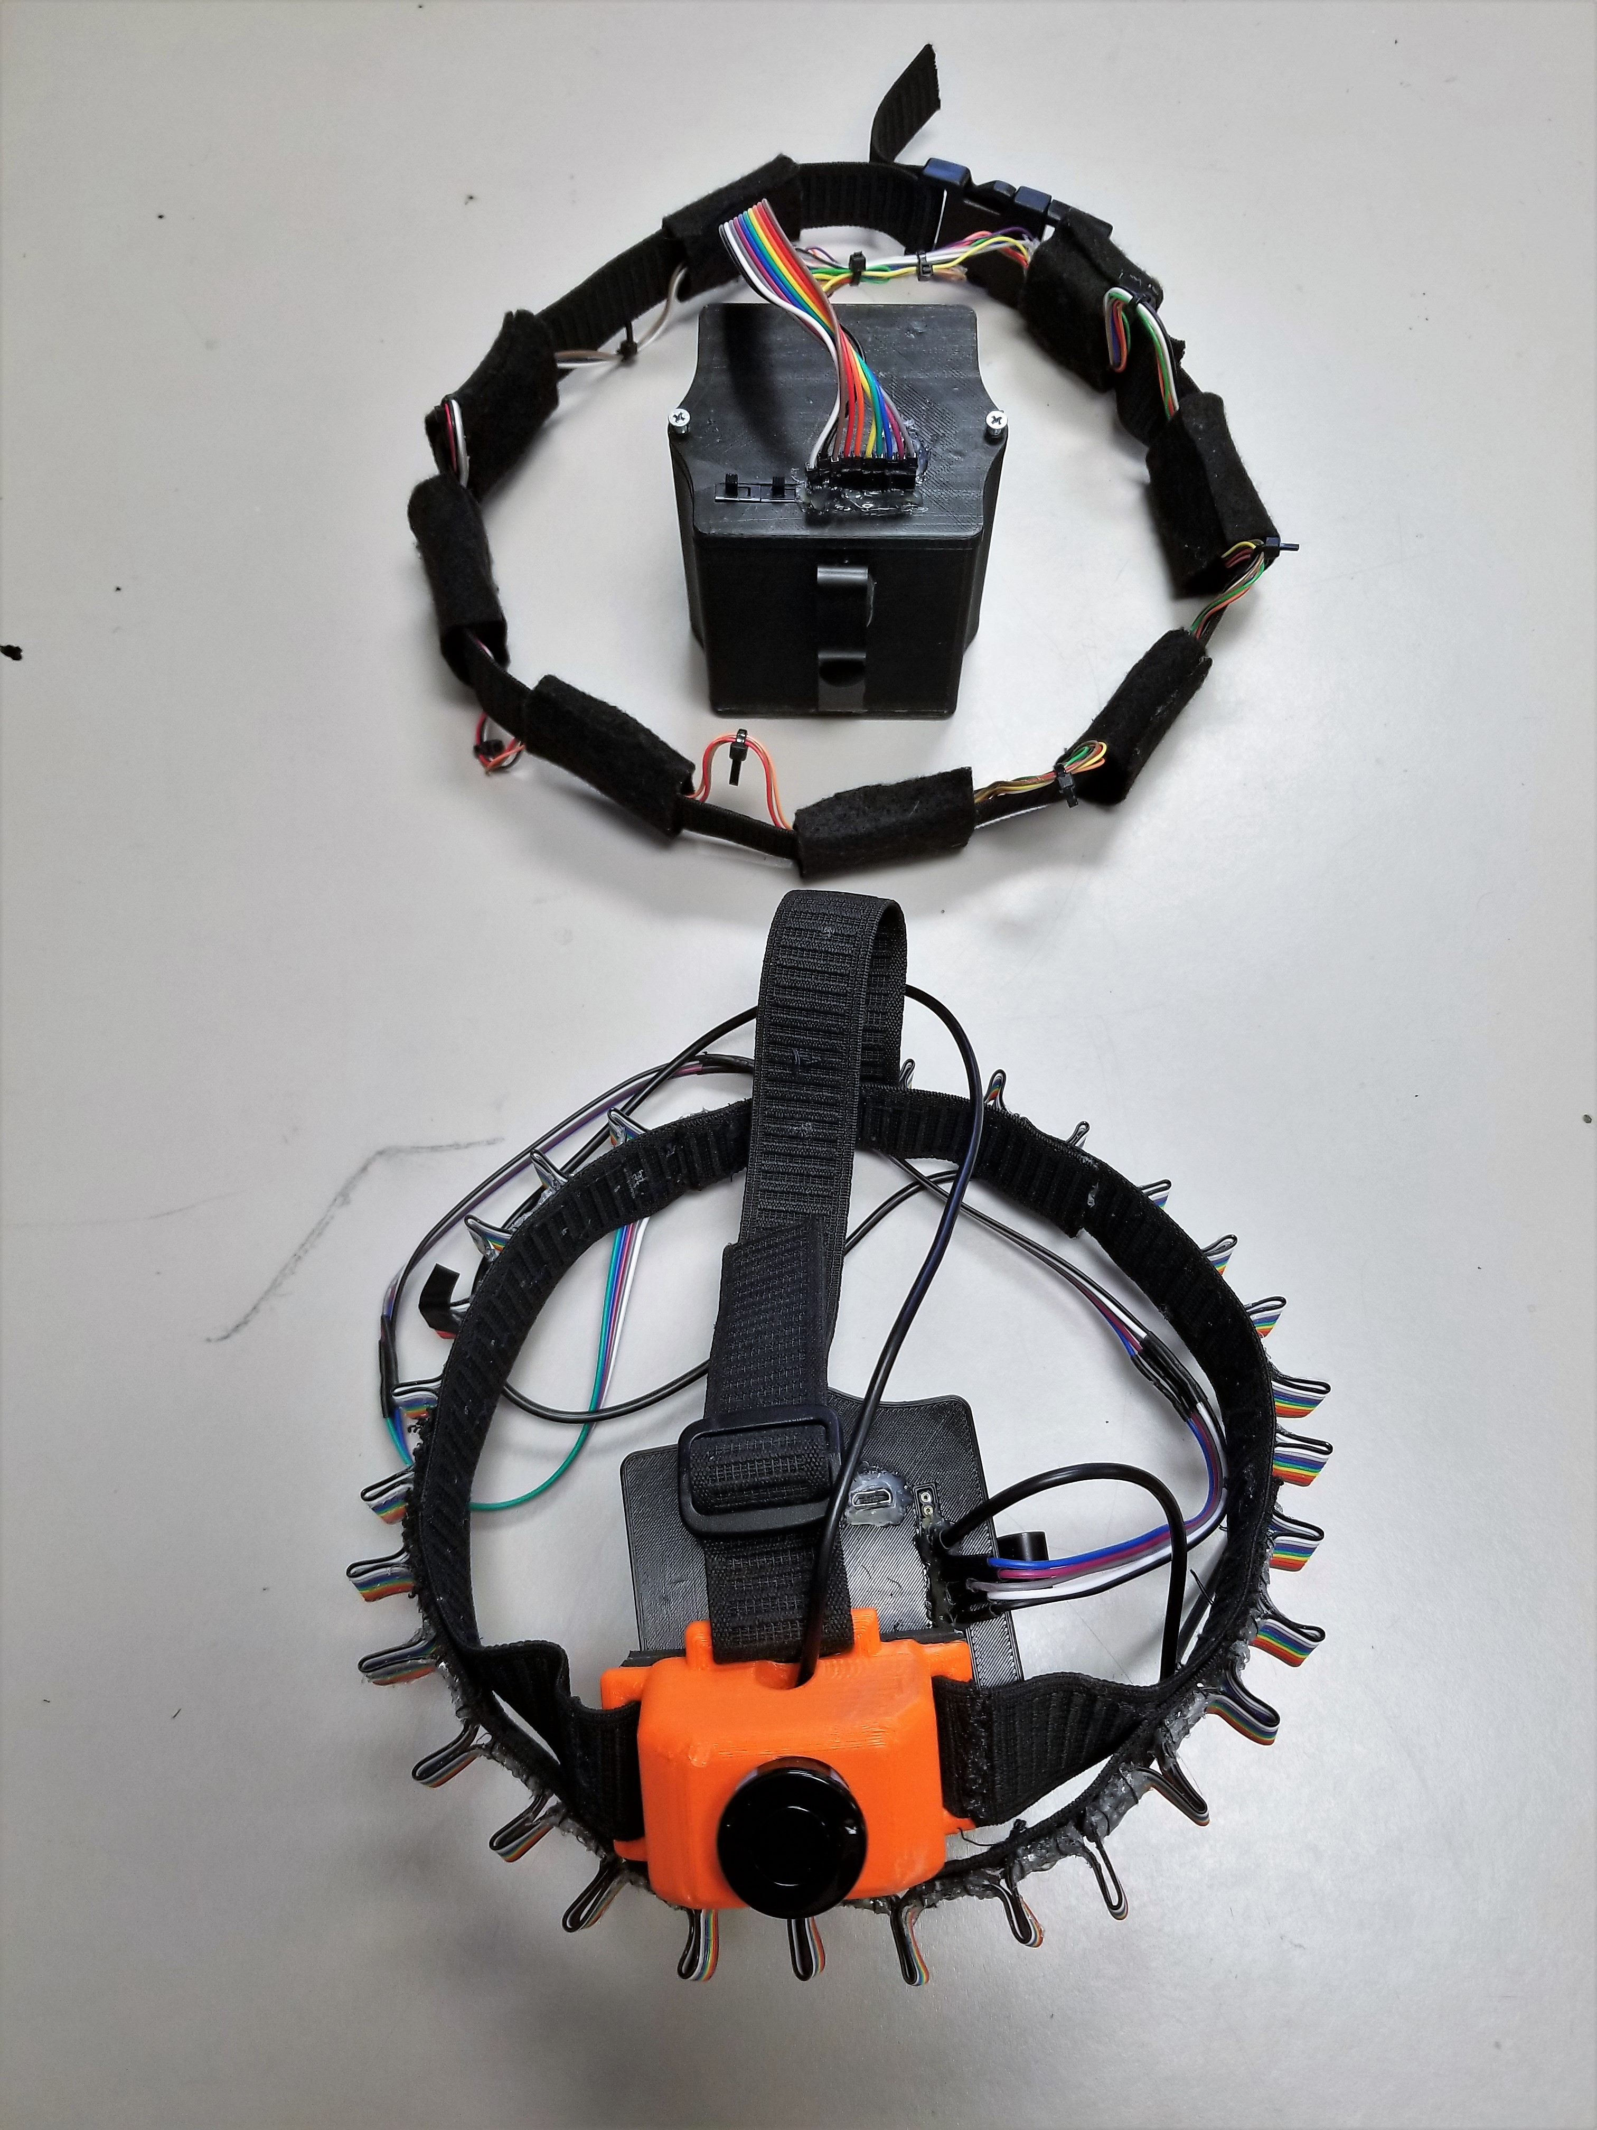
Ece #34
Block Diagram
Navigation assistance
for the vision impaired
Team Members
3.3V
Ultrasonic Sensor
Object Distance
and Direction
3.3V
3.3V
Laser Sensors
Sensor Controller
A wearable system that translates visual information into tactile feedback.
Power
Power Supply
3.3V
3.3V
1
System Overview
Jacy Barr(right) (barrja@oregonstate.edu)
Project Management
Harnesses and Enclosures
Haptic Feedback Modules
Samuel Lee(center) (leejiaks@oregonstate.edu)
Bluetooth Communication
Microcontrollers and Code
Sean Sylwester(left) (sylwests@oregonstate.edu)
Ultrasonic and IR Distance Sensors
Power Supply
PCBs
3.3V
Feedback Controller
Haptic Feedback
Vibrations
System takes in sensor data locating nearby objects in 360° from a headband of several types of sensors.
Sensor data is transferred wirelessly to a waistband of haptic feedback vibration motors, which are spread evenly around the band.
Haptic feedback motors vibrate with intensity corresponding to nearest object distance in that direction.
PROJECT MOTIVATION
253 million people worldwide live with vision impairment
36 million people are completely blind.
The White Cane has some significant drawbacks:
2
3
requirements
Difficult to use indoors and in crowded areas
Misses objects above waist-height
Minimum 12 hr battery life.
Battery will charge in less than 15 hrs.
9/10 users will determine the distance to an object with an accuracy of 1 m for objects within 5 m in front of the user, and 20cm for objects within 1 m in any direction.
Optional low-power mode with minimum 24 hr battery life, at the cost of 100 ms additional response time.
9/10 blindfolded users will turn into a doorway at the end of a 20 m long hallway without touching the walls.
Detected object direction is indicated to within 30°.
System feedback responds to changes in object position in less than 200ms.
Spraying 100mL of water over the entire system in two minutes will not damage the system.
The system weighs less than 900g, and after 15 minutes of use, 9/10 users report the system is comfortable.
Wireless connection between the sensor and feedback bands remain uninterrupted for 12 hours.
Other assistive technologies have problems as well:
Expensive
Uncomfortable
Unresponsive
Poor battery life
Not waterproof
Our system seeks to address the shortcomings of the White Cane while avoiding common pitfalls of other assistive technologies.
Object Detection Ranges
Green: Ultrasonic Sensor
Red: Laser ToF Sensors
Key technologies Used
30 VL53L0X Infra-Red Laser Time-of-Flight distance sensors
Small form factor
1.2m range
30ms measurement time
20mW power consumption each
JSN-SR04T ultrasonic distance sensor
5m range
40ms measurement time
Waterproof sensor enclosure
A
JSnJSasdjflk;
8 C0820B002F Haptic Feedback Motors
Small form factor
Low power consumption
Highly adjustable intensity level
HC-05 Bluetooth Modules
Arduino Pro-Mini Microcontrollers
6600 mAh Li-Ion Batteries
Student-designed PCBs and Enclosures

